Slide 1

Nmap SearchSploit
Automation Tool
Automated Vulnerability Scanning & Exploit Lookup with PDF Reporting

Slide 2




Introduction to the Tool
Streamlining vulnerability assessment processes.
Automated Scanning
Efficiently identifies network vulnerabilities.
Exploit Lookup
Integrates with SearchSploit for relevant exploits.
PDF Reporting
Generates comprehensive and shareable reports.

Slide 3
Key Features
Powerful options for tailored vulnerability scans.
Nmap Scan Control
Integrated Exploit Search
Reporting & Privileges
User-selectable timing templates (T1-T5)
Extracts services and versions from Nmap XML
Generates detailed PDF reports
Requires sudo for full scanning capabilities
Flexible port scan options (all or common)
Searches SearchSploit for relevant exploits
Aggressive scan (-A) and service version (-sV) detection

Slide 4

System Requirements
Ensure your environment is ready for deployment.
Python 3.6+
Modern Python version for script execution.
Nmap Installed
Network discovery and security auditing tool.
SearchSploit Installed
Exploit-DB command line search tool.
fpdf Python Package
Library for PDF document generation.

Slide 5
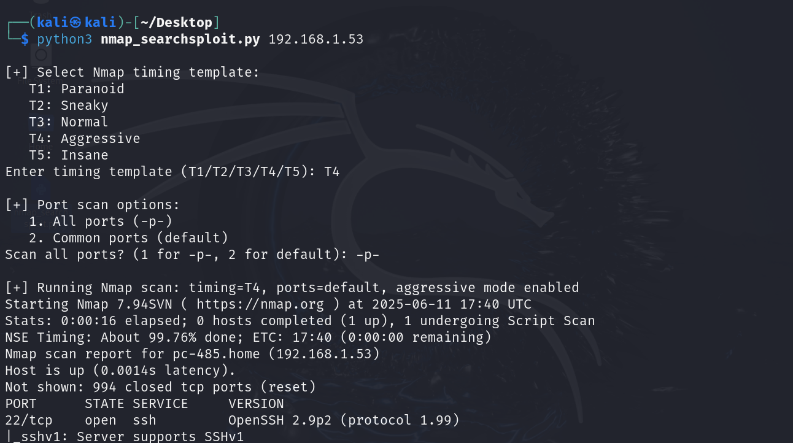

Slide 6
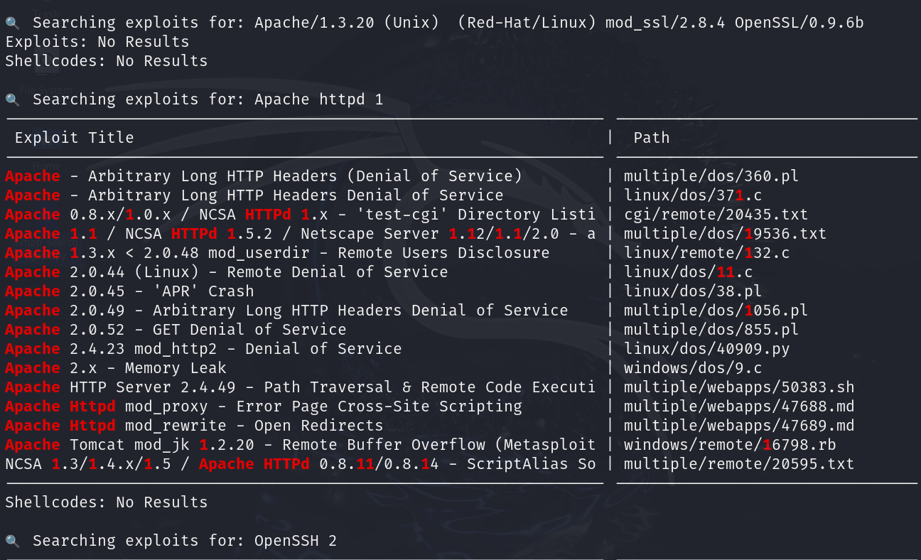

Slide 7
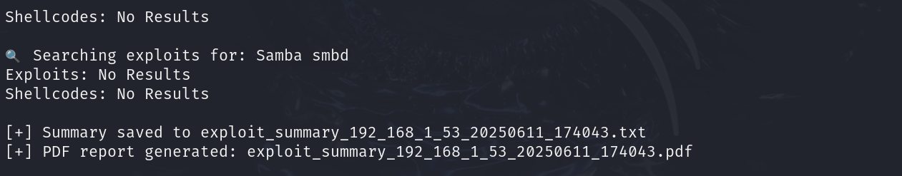

Slide 8





Tool Usage
Executing scans and understanding command line options.
Run Command
Timing Template
Port Scan
Example
sudo python3 nmap_searchsploit.py <target>
Choose all ports or common ports.
sudo python3 nmap_searchsploit.py 192.168.1.1
Select scan aggressiveness (T1-T5).

Slide 9








How It Works
The internal flow from scanning to exploit discovery.
Nmap Scan
XML Parsing
Runs with selected options.
Extracts services, versions.
SearchSploit Lookup
Output Generation
Finds exploits by product and version.
Console, text, and PDF reports.

Slide 10



Troubleshooting Tips
Common issues and how to resolve them.
Python Modules
Install missing packages (e.g., pip3 install fpdf).
Sudo Privileges
Always run the script with sudo.
Tool Paths
Ensure Nmap and SearchSploit are in your PATH.

Slide 11

Future Enhancements
Ongoing development for advanced capabilities.
CVE Severity Scoring
Integrate with vulnerability databases.
HTML Reports
Dynamic and interactive reporting options.
Metasploit Integration
Automate exploit testing and validation.
Performance Boosts
Multi-threaded scanning and searching.

